Slide 1

R: It's Not Just For Pirates Anymore
Dustin Ewers
Consultant @ Centare
Code: https://github.com/DustinEwers/r-talk-demos
Website: www.dustinewers.com
Notes:
Slide background from: www.subtlepatterns.com

Slide 2
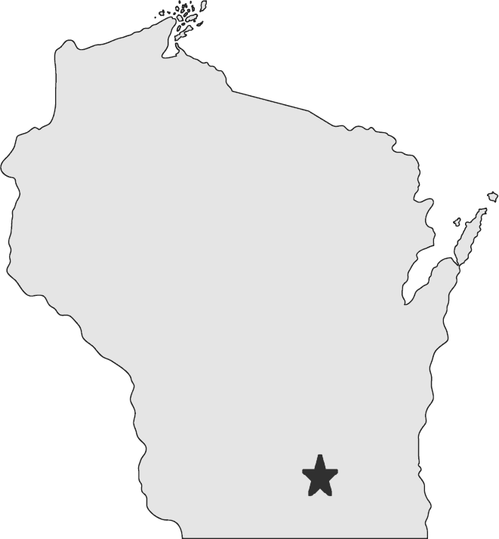

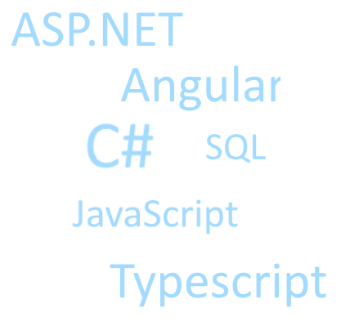
My Story
Notes:
10 years of Web Dev on the Microsoft stack
Hail from the Hipster Capital of the Midwest, Madison
I’m not a data scientist and I don’t play one on TV.
I lack a PHD in statistics…
We are awash in data, so I’m trying to learn different tactics to deal with it
I think data literacy is important and learning this programming language is one way to do it.

Slide 3
What is data literacy anyway?
Notes:
An understanding of how to use data and interpet it.
Knowing things like:
correlation != causation
Survey data being sketchy
Understanding the difference between different measures of central tendencies
The importance of larger sample sizes

Slide 4
Roadmap
Why Data Literacy?
Why R?
A Brief Tour of R

Slide 5
Why do we need data literacy?
Notes:
Why care about data topics?

Slide 6
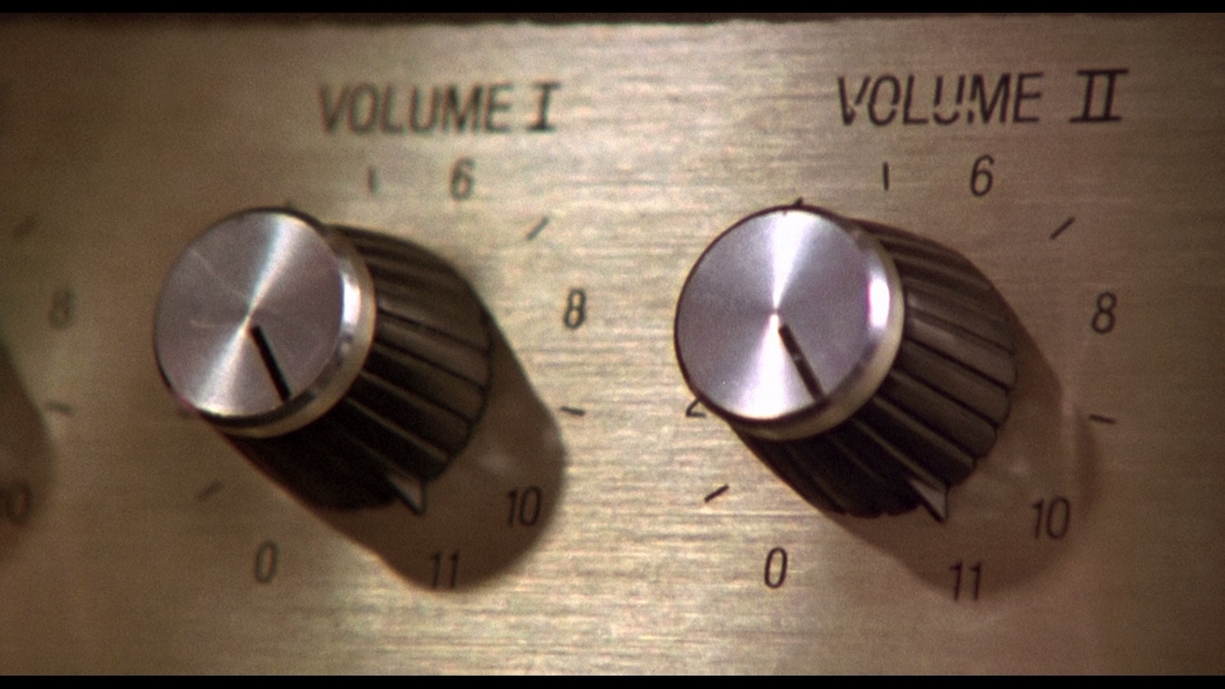
Notes:
Volume-
Volume Statistics - http://www.internetlivestats.com/

Slide 7



6000 / second
40,000 / second
80,000,000 / month
Notes:
Data users intentionally generate
6000+ Tweets send per second (http://www.internetlivestats.com/twitter-statistics/ -- http://www.internetlivestats.com/one-second/)
40,000+ google searches / second (http://www.internetlivestats.com/google-search-statistics/)
- 80,000,000 WordPress posts / month https://wordpress.com/activity/posting/

Slide 8

Notes:
Data users unintentionally generate
- Logs, usage stats, creepy tracking stuff (that makes you want to put on a tinfoil hat and live in the woods)

Slide 9
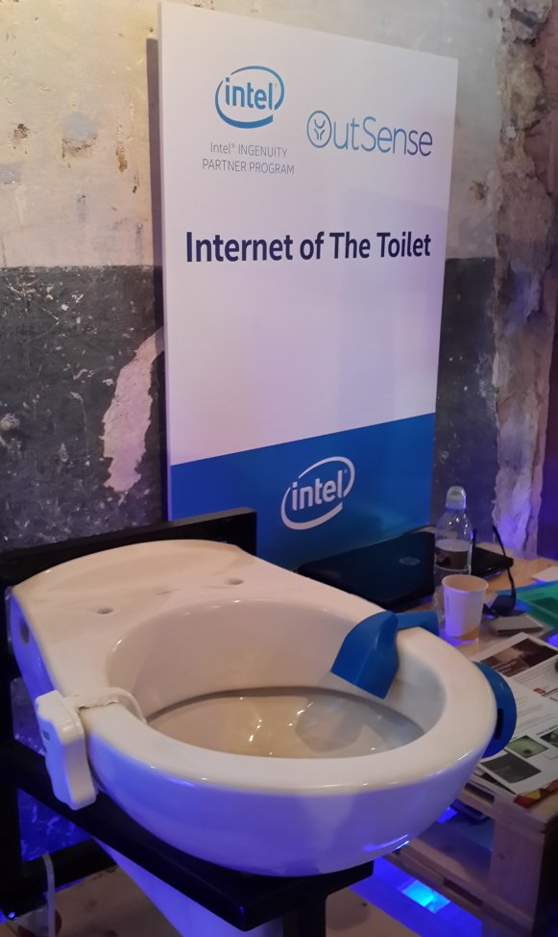

Notes:
Collected Data
IOT
Government statistics

Slide 10
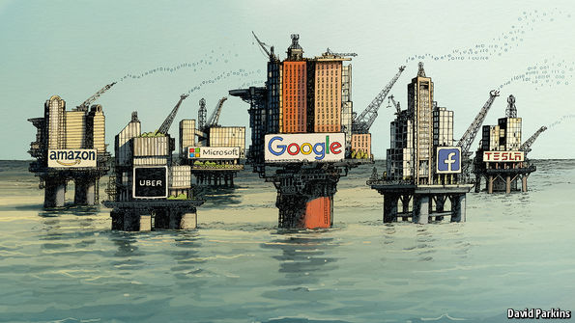
Data is the New Oil
Notes:
http://www.economist.com/news/leaders/21721656-data-economy-demands-new-approach-antitrust-rules-worlds-most-valuable-resource
(This article talks about how the massive data stores of big companies gives them a huge competitive advantage)
There’s money to be made on data.
If you like money, data is for you.
---
“If the service is free, you’re the product.”

Slide 11


Notes:
Wanna hear something really creepy?
Target
Tons of analytics being collected
Is able to make some scary predictions. (Minority Report)
Lots of companies can do this now, and I want to understand the process.
https://www.forbes.com/sites/kashmirhill/2012/02/16/how-target-figured-out-a-teen-girl-was-pregnant-before-her-father-did/#5ce70ddc6668
Photo:
https://www.pexels.com/photo/man-person-face-portrait-34667/

Slide 12
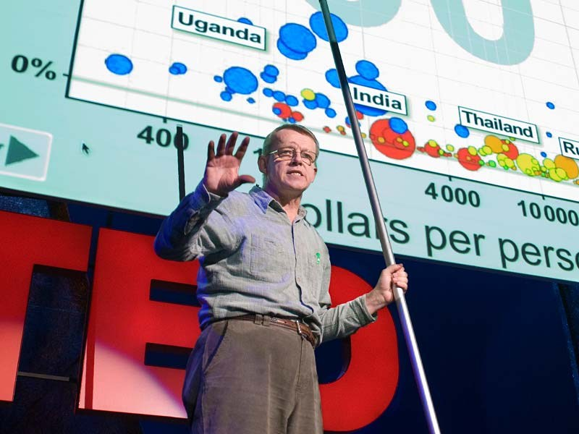
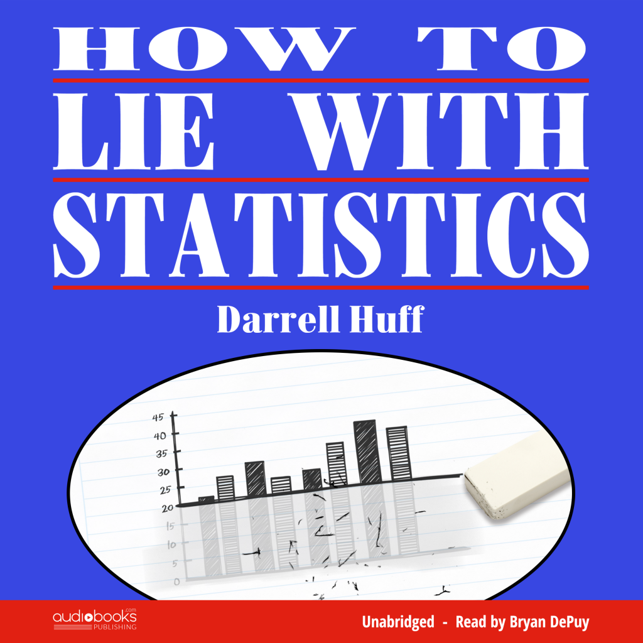
Notes:
… there’s good guys and bad guys.
People are trying to manipulate you with numbers

Slide 13
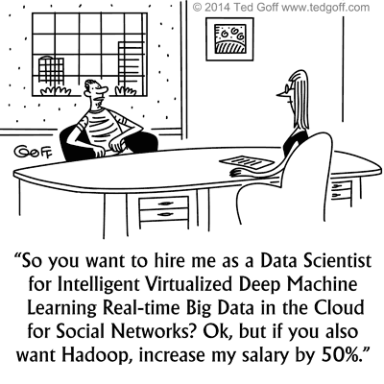
Notes:
http://www.kdnuggets.com/2014/04/cartoon-data-scientist-salary-negotiation.html
You may have to work with a data scientist…
Even if you don’t do the analysis, you might have to implement the product.
Netflix example.
R is often translated into other languages for inclusion in software products.

Slide 14
Data Analysis Languages
Notes:
Python and R are the two heavy hitters in this space.
Python – Easy to learn OOP Scripting Language. The default choice for academics
R – “built by statisticians, for statisticians” | Based on the S programming language, it came in 2000 and has been steadily gaining in popularity with data scientists.
Scala – Distant third - JVM based language. Like a more functional version of C#
There are other languages: Julia, Go, etc…
R and Python are roughly tied.
http://www.kdnuggets.com/2017/05/poll-analytics-data-science-machine-learning-software-leaders.html
http://www.infoworld.com/article/3049672/application-development/which-freaking-big-data-programming-language-should-i-use.html
https://en.wikipedia.org/wiki/R_(programming_language)
https://en.wikipedia.org/wiki/S_(programming_language)
https://en.wikipedia.org/wiki/Python_(programming_language)
https://en.wikipedia.org/wiki/Scala_(programming_language)

Slide 15
Which one should I choose?
Notes:
Trick question… they’re all good. (though we’re going to talk about R)
Consultant answer – it depends.
Each has their own flavor and advantages.
Scala is great for people who are familiar with JVM tools. It’s also great for talking to Apache’s big data tools, like Spark. (relate my experience using .NET for this purpose)
Scala is also statically typed.
Python is really easy to learn and it’s used in lots of different places. You should pick it up for that reason alone. Python excels at data cleanup.
R is great at statistical analysis.
-----
As someone who lives in the Microsoft ecosystem, Python and R are intriguing to me because they’re supported in Visual Studio.
-----
I’m personally an advocate of the polyglot approach. Learn them all…

Slide 16
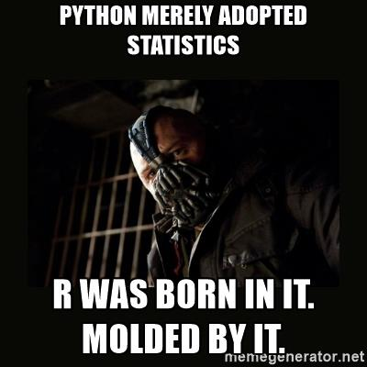
R vs. Python

Slide 17
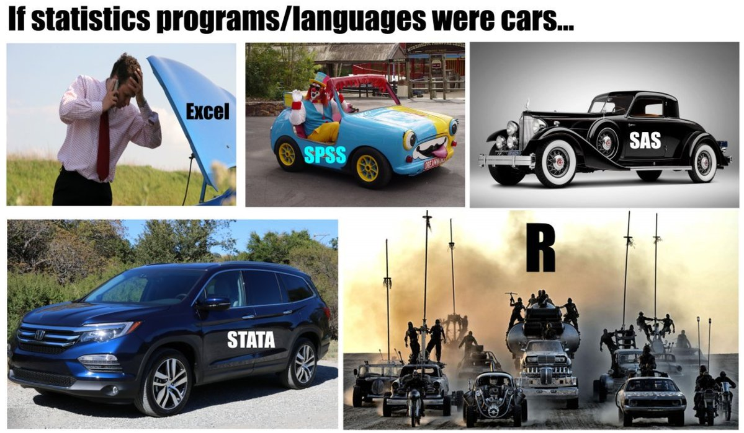
R vs. Other Stats Tools
Notes:
I’m going to be honest, I don’t know much about other stats tools, but someone sent me this.

Slide 18
Why R?

Slide 19
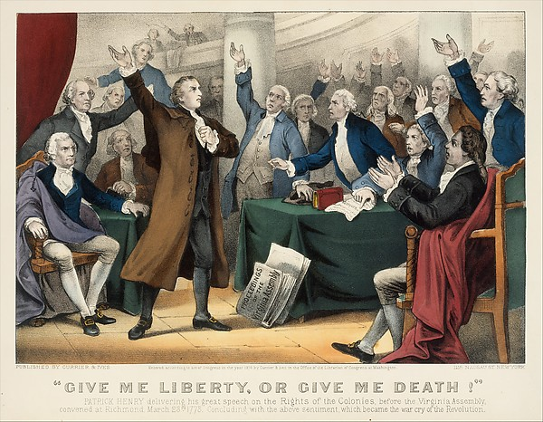

Why R? – Free & OSS
Notes:
Free as in speech and beer.
Unlike some commercial packages that cost tons of cash.
http://www.metmuseum.org/art/collection/search/380487

Slide 20

Made specifically for statistics…
Notes:
Made by statisticians, for statisticians.
If there’s a statistical thing you want to do, there’s probably a package for that already.
It smooths out any rough edges in the data exploration process.

Slide 21
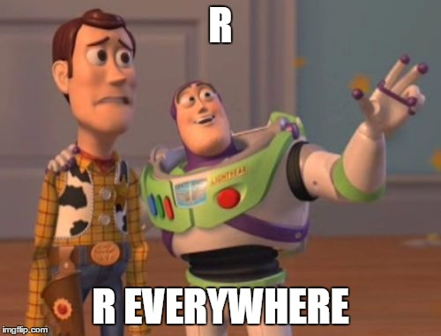
Notes:
Visual Studio or rStudio
SQL Server
Jupyter Notebooks
Zeppelin Notebooks
Low Ceremony

Slide 22
When to use it?
Data Exploration
Statistical Analysis
Data Visualization
Notes:
R really shines at ripping through datasets and building models.

Slide 23
When to not use it?
Anything Non-statistical
Complex applications
Notes:
R is not a general purpose language.
It shouldn’t be used in situations with no data analysis
While it can build web apps, you aren’t going to build the next Google or Facebook in R
Some people also claim that R isn’t great at big data, but R can plug into lots of big data tools.

Slide 24
R Basics – Demo
Notes:
Dynamically typed
Interpreted – often run interactively
Multi paradigm, mostly functional
The primary R – IDE is R Studio, though Visual Studio has decent R support.
-- Fire up some demos

Slide 25

Different Flavors of R
Notes:
CRAN Version – Standard R | R development core team (CRAN stands for Comprehensive R Archive Network)
Microsoft Version - MRAN | “Enhanced R”
https://mran.microsoft.com/open/
Tradeoff - Microsoft is faster, CRAN is newer.
Others:
TIBCO – commercial R, costs money
Photo:
https://www.pexels.com/photo/red-green-and-white-ice-cream-scoops-on-brown-cone-200909/

Slide 26
Demos

Slide 27
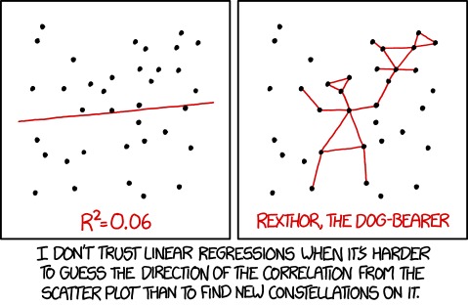
Notes:
Pre-stats demo
https://xkcd.com/1725/

Slide 28

Notes:
Pre machine learning demo 1
https://xkcd.com/1838/

Slide 29



Iris Setosa
Iris Virginica
Iris Versicolor
Notes:
Let’s talk about flowers… our dataset uses these three species of flowers.
Pre machine learning 2

Slide 30
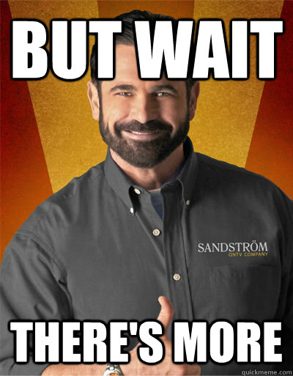
Common Packages
dplyr
ggplot2
xlsx
quantmod
Shiny
Notes:
Over 10k packages
https://cran.r-project.org/web/packages/
https://support.rstudio.com/hc/en-us/articles/201057987-Quick-list-of-useful-R-packages
dplyr - data selection and cleanup
tidyverse – a bunch of data manipulation packages
ggplot2 – popular data viz library
xlsx – workwith Excel files
quantmod – financial data
Shiny – web framework

Slide 31
Takeaways
Data (in all sizes) is a gold mine
R is great for learning
R is great for data exploration
Notes:
Data (in all sizes) is a gold mine
- Big data, small data, we love all data.
R is a great way to learn about stats
there’s lots of built in help and datasets to learn from
R is a fantastic data exploration tool
It can slice and dice datasets with ease
It’s usable in a variety of ways
-- Call to action
So get R, and slice you data with ease

Slide 32


